Slide 1

SMU AR
Alwaleed Alqufaydi
Hassan Al Hukash

Slide 2
Description
An augmented reality application to allow students, staff and visitors to have a fun and exciting experience around SMU’s campus.

Slide 3
Problem
The Admission Office wants to view some facts about the buildings around campus in a unique way.
A guided tour decreases the interest level of campus visitors.
Tours are usually timed, so tour guides may skip some facts about some building due to time constraints.

Slide 4
Solution
Provide an app that helps students and staff know their surroundings.
Display facts about buildings
Allow visitors to roam around campus freely without having to be stuck with a guide
Create a unique experience for visitors and new students.

Slide 5
Our Client
The client for this project is the admission office Saint Martin’s University
Our Contact: Rebecca Byrne

Slide 6
Client Needs:
Build an application for smartphone users that can scan QR codes and display a fact about a building or a historical fact about saint martin’s university.

Slide 7
Method Used
Agile Software development
We chose the agile method because it fits into our application criteria.

Slide 8
Deliverables:
Product vision statement: Our goal is to complete the application on time with no technical issues or bugs and make the application smooth to run on android devices.
Product roadmap: Devices & software Used in the project
An android smartphone with a camera
An Augmented reality tool (Vuforia)
3D & Graphics design tool (Unity)
Android Studio (Integration with Unity)
Clear QR codes to be scanned by app

Slide 9
Deliverables:
Product backlog:
Have a clear understanding of Augmented reality
Understand how to map 2D objects onto a 3D object
Integrate Unity with Android Studio
Build a sample app to see how everything will work
Design the UI
Create Back Buttons
Integrate a google map of Campus
Test the application for bugs
Deploy the application

Slide 10
Process continue ..
Software Used
Unity
Vuforia
Android Studio
Pure APK
Unity: We used Unity to create the UI and the overall functionality (Buttons, Maps, AR mapping)
Vuforia: We used an AR engine (Vuforia) and a database to upload all our targets
Android Studio: We used (SDK) to build the app and be able to integrate Unity into the app
Pure APK: is used to install pure APK files without uploading the application to Google Store (USB Debugging Mode)

Slide 11
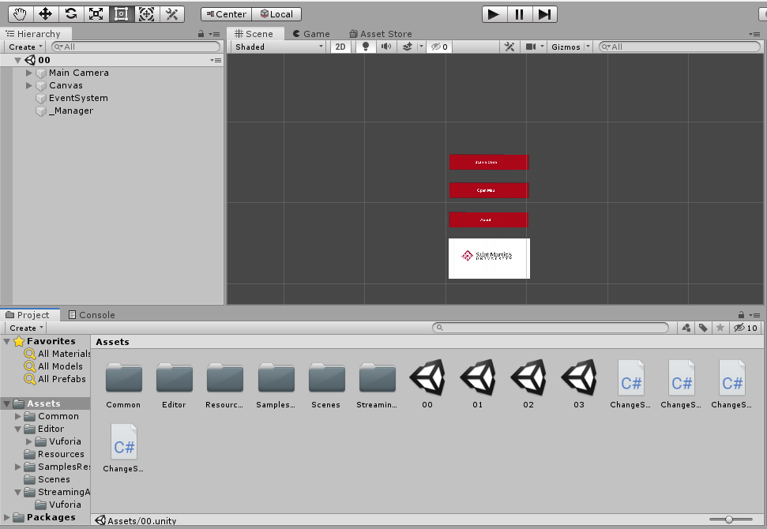
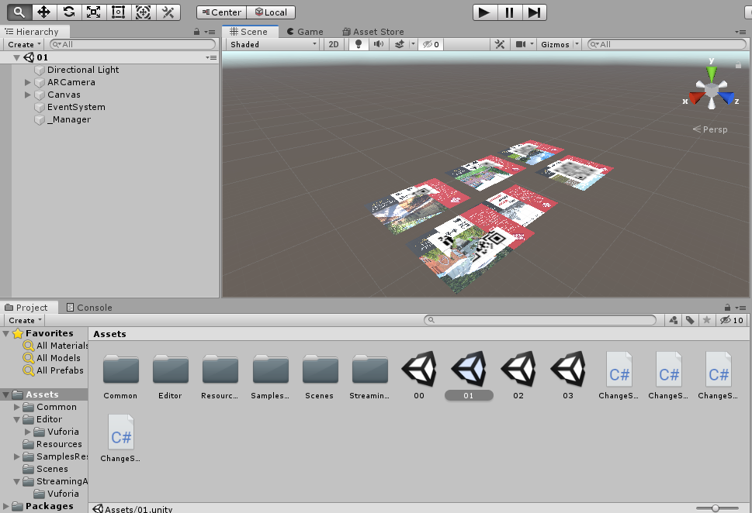
Process cont ...
Unity:
Add Vuforia and obtain free License
Create multiple Scenes in Unity to create the UI

Slide 12
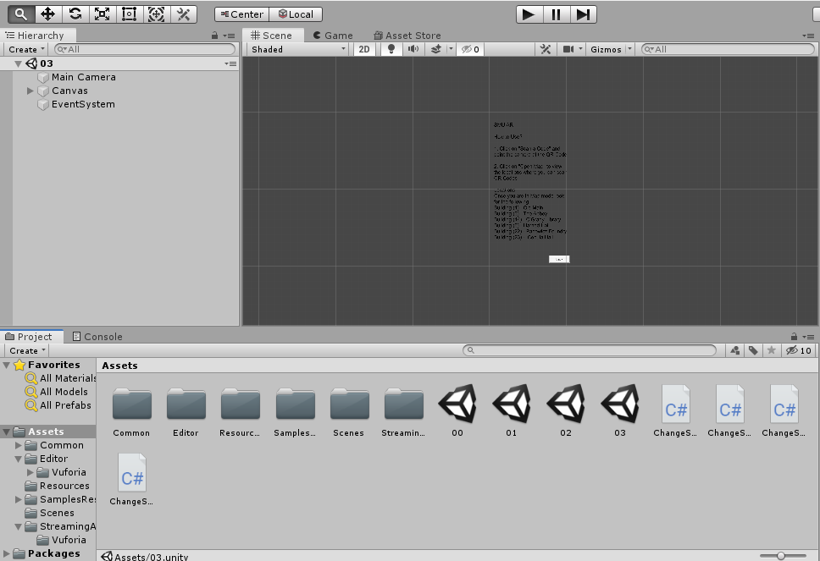
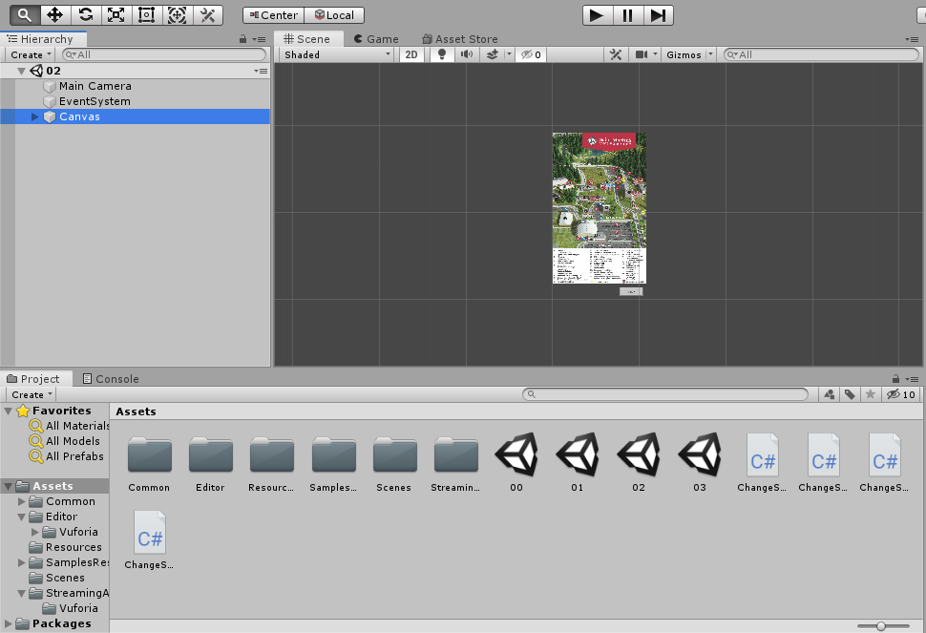
Cont … (Unity)

Slide 13
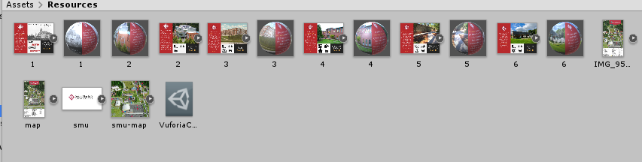
Process (Unity)
Resources

Slide 14
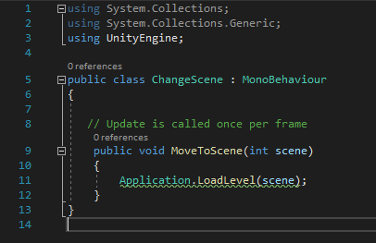
Process (Unity)
Code Used

Slide 15
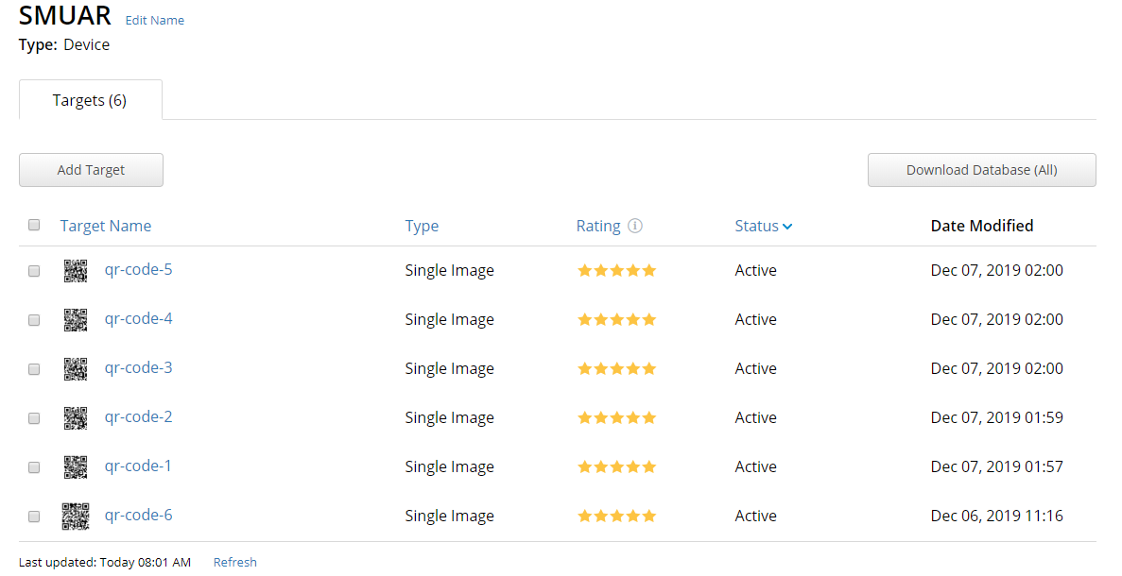
Process (Vuforia)
Database and Targets

Slide 16
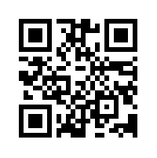
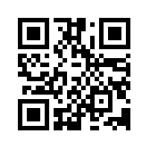
Process (Vuforia)
QR-Codes Sample

Slide 17
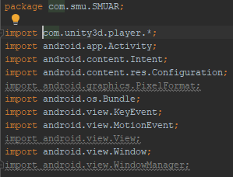
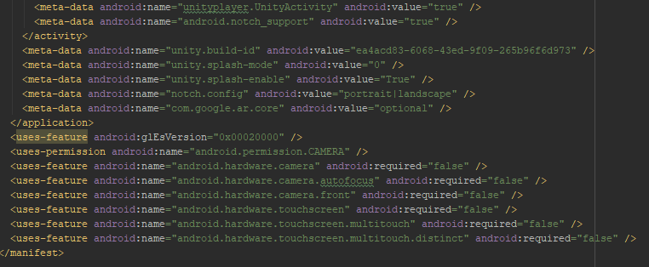
Process (Android Studio)

Slide 18

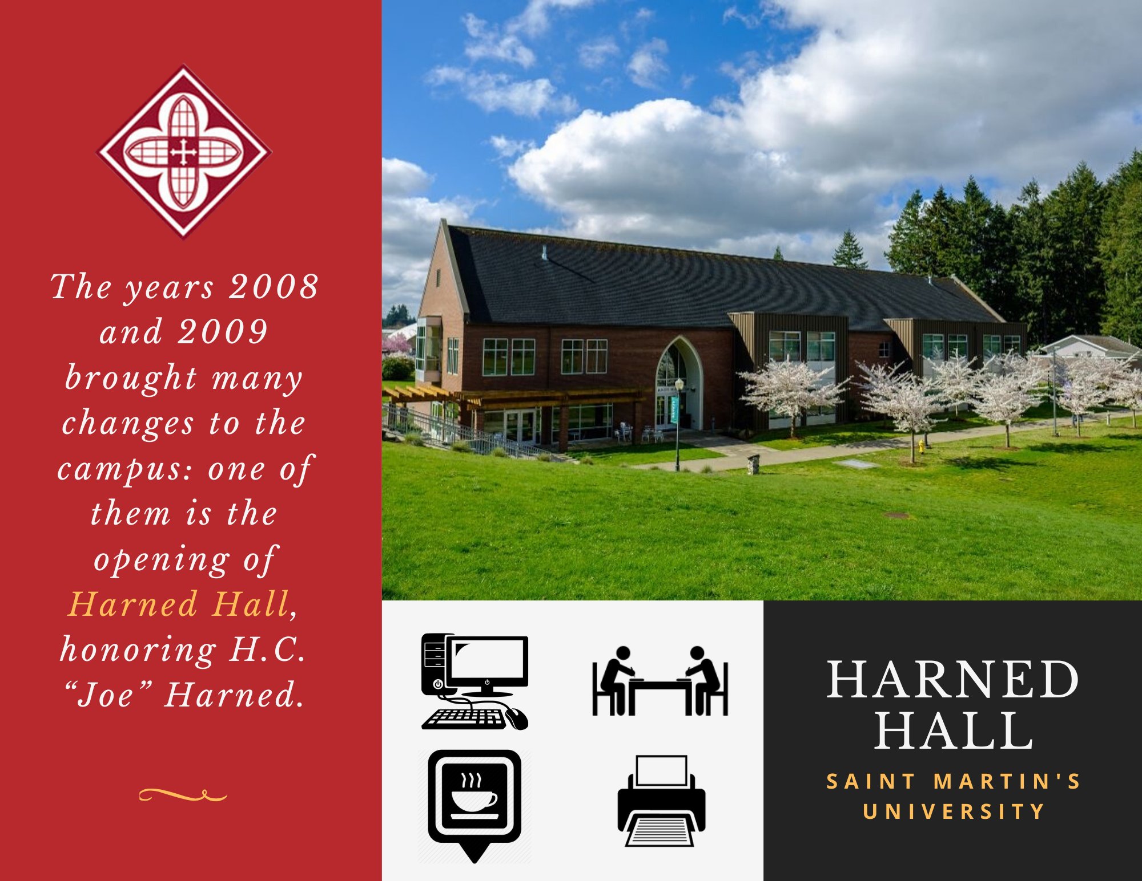
Design
We created samples to add into our app

Slide 19
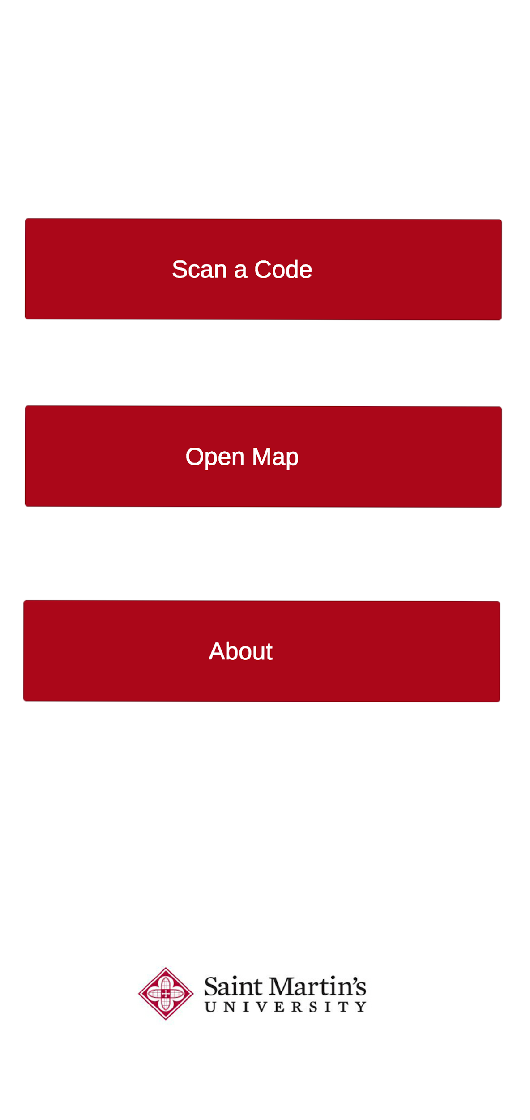
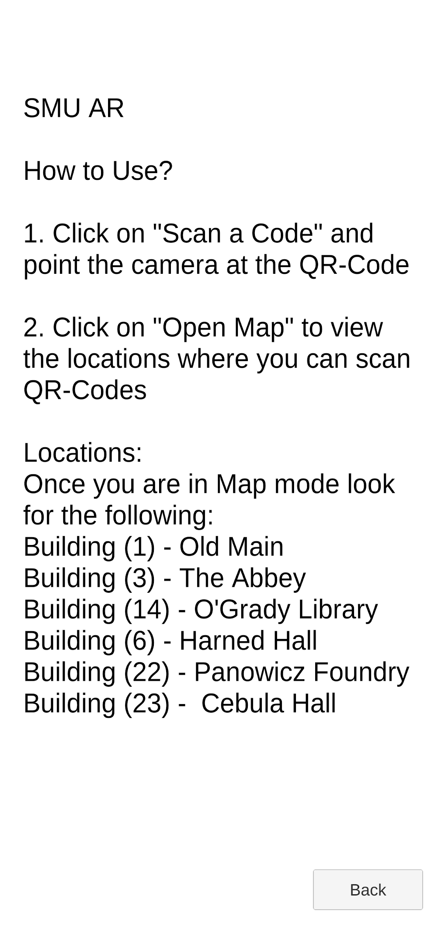
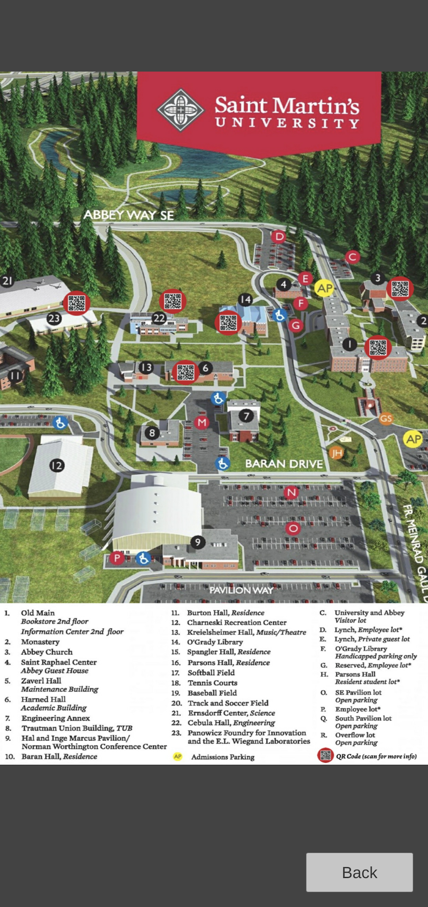
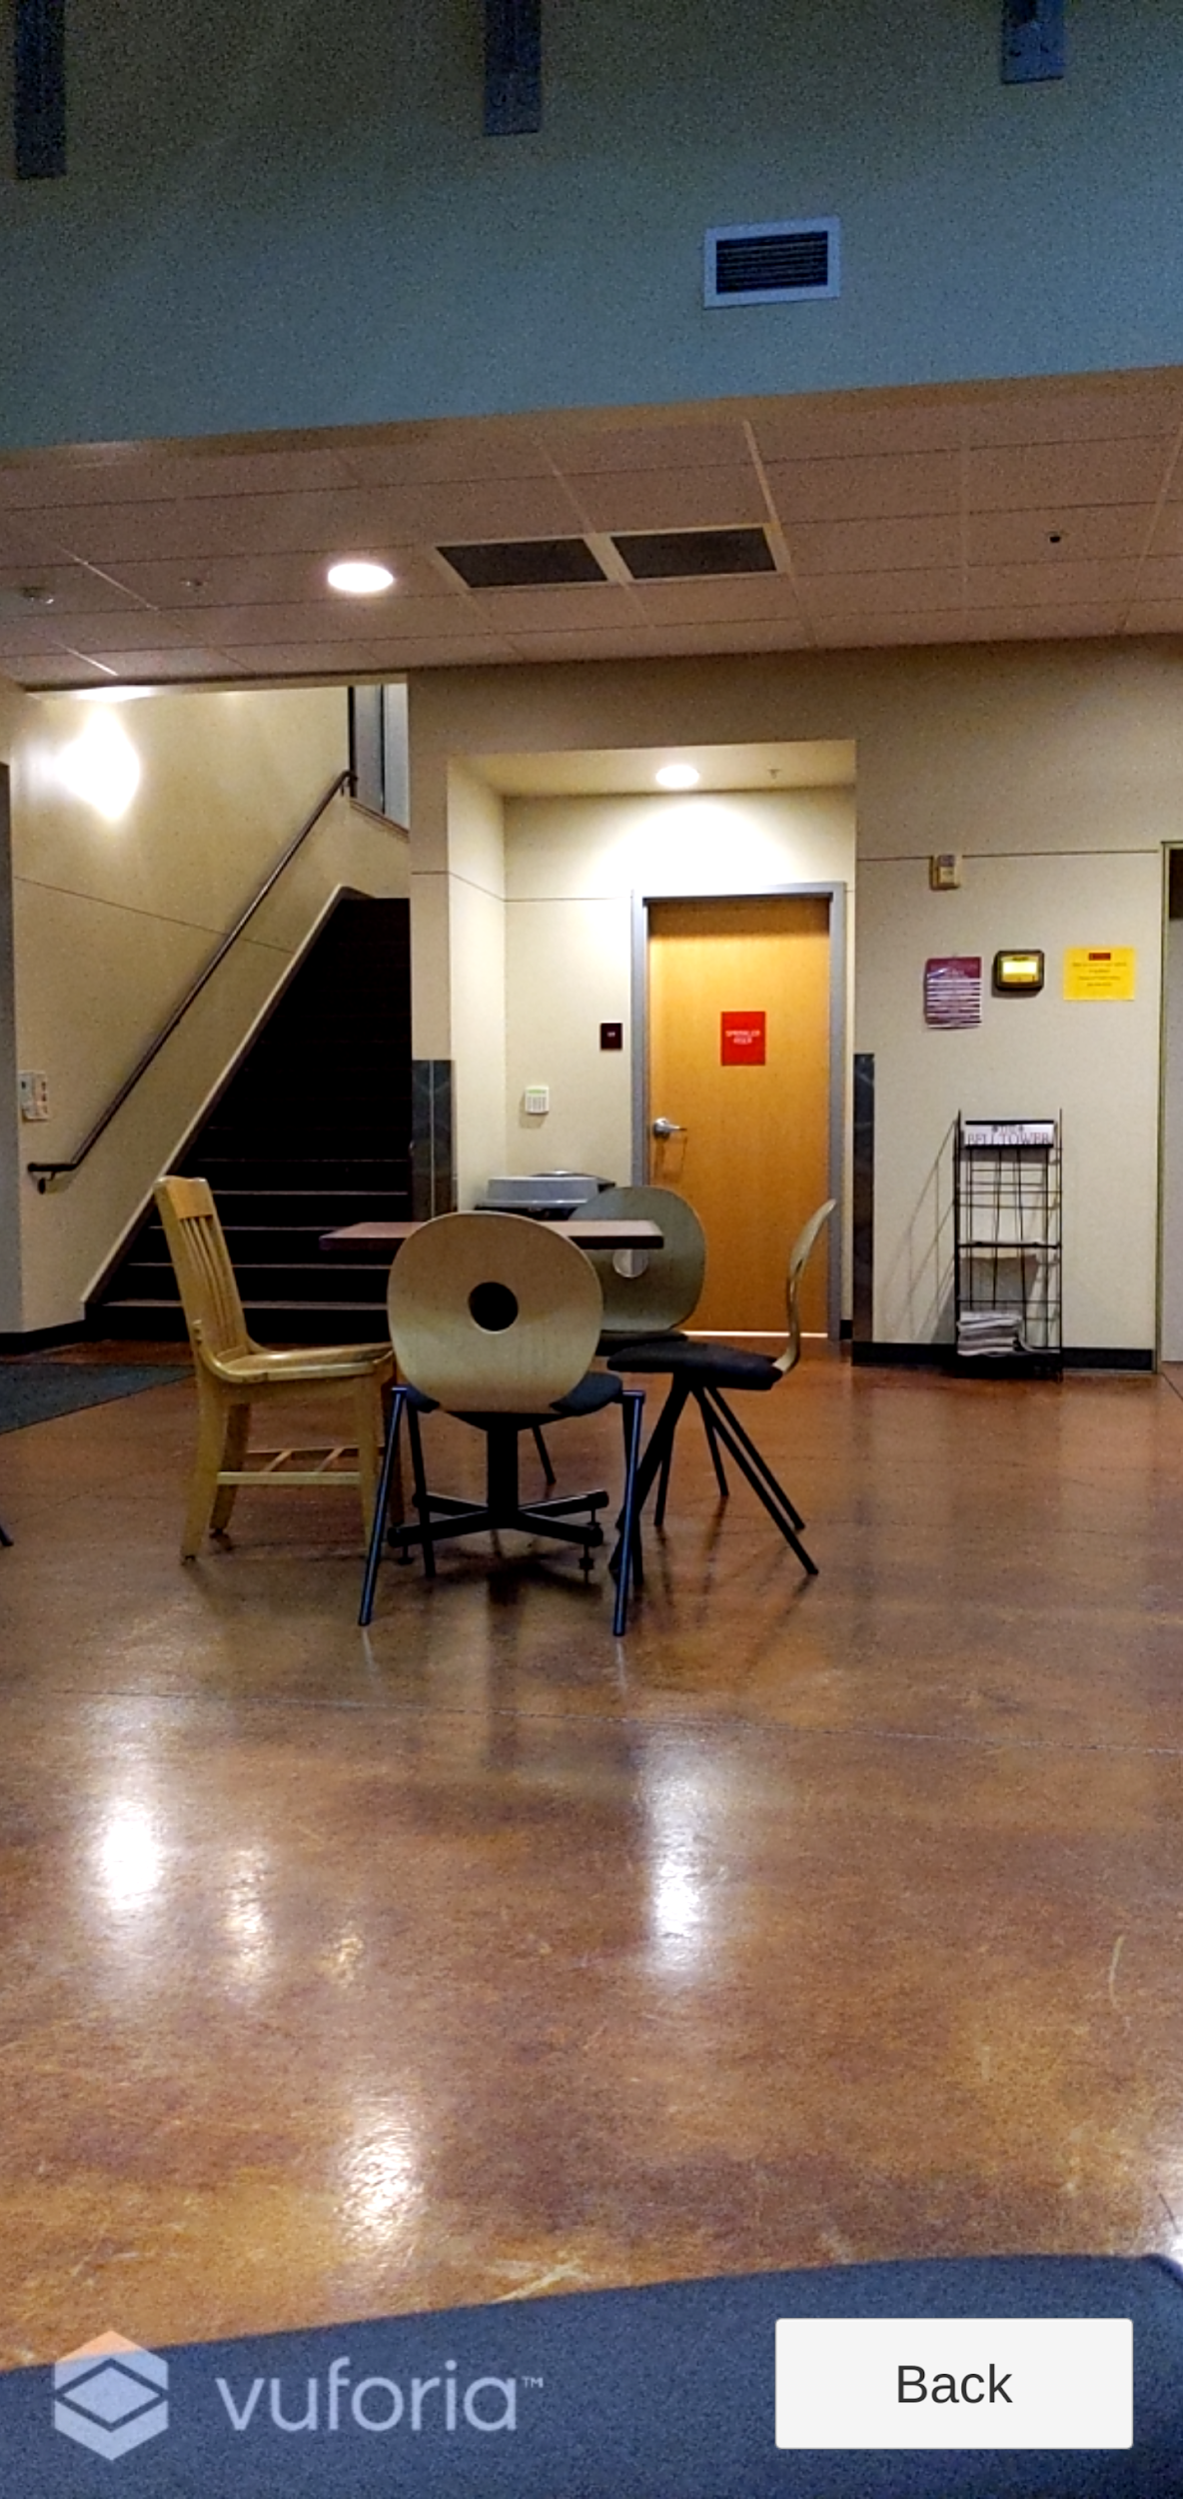
Design (UI)

Slide 20

Demo

Slide 21
Questions
?

